Slide 1
Applications of Lagrangian duality in Boolean function analysis
Shuchen Li (Peking University)
Advisor: Qian Li (Institute of Computing Technology)

Slide 2
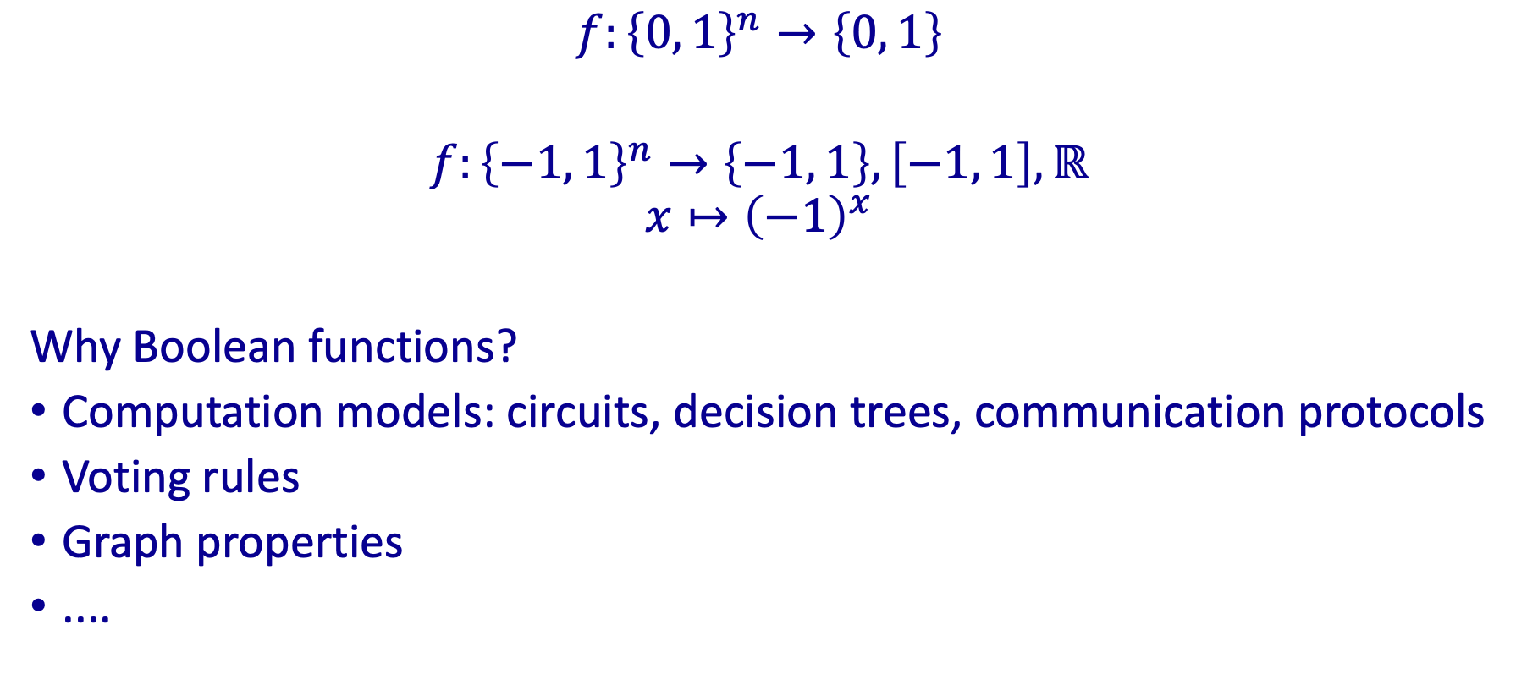
Boolean functions
1
-
1
-
$$f:{\left\{0, 1\right\}}^{n}→\left\{0, 1\right\}$$
$f:{\left\{−1, 1\right\}}^{n}→\left\{−1, 1\right\}, \left[−1, 1\right], ℝ$
$$x↦{\left(−1\right)}^{x}$$
Why Boolean functions?
Computation models: circuits, decision trees, communication protocols
Voting rules
Graph properties
....
0
0
+
+
0
+
0
+
1
-
1
-

Slide 3

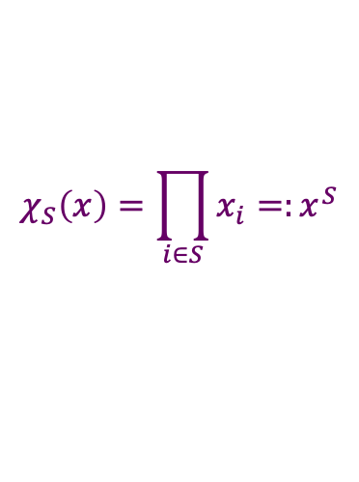

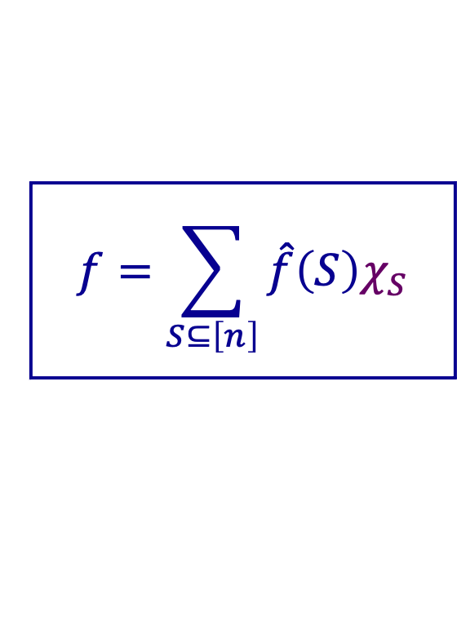


Fourier expansion
Represent $f:{\left\{−1, 1\right\}}^{n}→ℝ$ in the basis of parity functions
$$f=\sum_{S⊆\left[n\right]}{\hat{f}\left(S\right)χ_{S}}$$
$$χ_{S}\left(x\right)=\prod_{i∈S}{x_{i}=:x^{S}}$$
$${\text{Maj}}_{3}\left(x_{1},x_{2},x_{3}\right)=\frac{1}{2}x_{1}+\frac{1}{2}x_{2}+\frac{1}{2}x_{3}−\frac{1}{2}x_{1}x_{2}x_{3}$$
Degree: $\text{deg}\left(f\right)=\text{max} \left\{\left|S\right|:\hat{f}\left(S\right)≠0\right\}$
$$D\left(f\right)≥\text{deg}\left(f\right)$$
$$Q_{0}\left(f\right)≥\text{deg}\left(f\right)/2$$

Slide 4

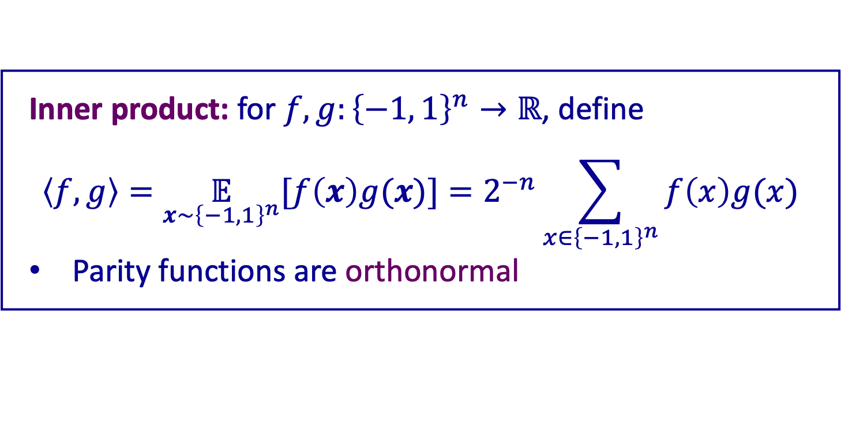
Inner product & norms
Inner product: for $f,g:{\left\{−1, 1\right\}}^{n}→ℝ$, define
$$\left\langle f, g\right\rangle =\underset{x\sim {\left\{−1, 1\right\}}^{n}}{𝔼}{[f\left(x\right)g(x)]}=2^{−n}\sum_{x∈{\left\{−1, 1\right\}}^{n}}{f\left(x\right)g(x)}$$
Parity functions are orthonormal
$p$-norm: for $f:{\left\{−1, 1\right\}}^{n}→ℝ$, $p∈[1, ∞]$, define
$${\left\|f\right\|}_{p}=\underset{x∼{\left\{−1, 1\right\}}^{n}}{𝔼}{[|f(x)|^{p}]}^{1/p}$$

Slide 5
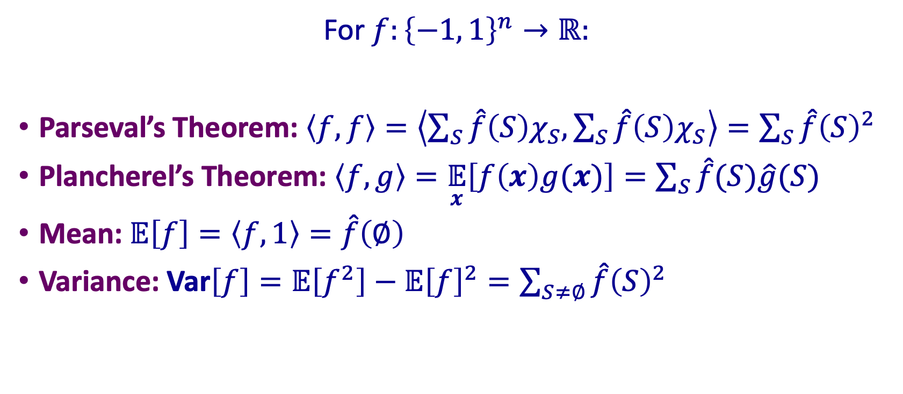
Basic Fourier formulas
For $f:{\left\{−1, 1\right\}}^{n}→ℝ:$
Parseval’s Theorem: $\left\langle f,f\right\rangle =\left\langle \sum_{S}{\hat{f}\left(S\right)χ_{S},}\sum_{S}{\hat{f}\left(S\right)χ_{S}}\right\rangle =\sum_{S}{\hat{f}{\left(S\right)}^{2}}$
Plancherel’s Theorem: $\left\langle f,g\right\rangle =\underset{x}{𝔼}\left[f\left(x\right)g(x)\right]{=\sum_{S}{\hat{f}(S)\hat{g}(S)}}$
Mean:$𝔼\left[f\right]=\left\langle f, 1\right\rangle =\hat{f}\left(∅\right)$
Variance: $\text{Var}\left[f\right]=𝔼\left[f^{2}\right]−𝔼{\left[f\right]}^{2}=\sum_{S≠∅}{\hat{f}{\left(S\right)}^{2}}$

Slide 6


Convolution
Let $f, g:{\left\{−1, 1\right\}}^{n}→ℝ$, define their convolution:
$$\left(f∗g\right)\left(x\right)=𝔼_{y\sim {\left\{−1, 1\right\}}^{n}}\left[f\left(y\right)g\left(xy\right)\right].$$
$$\begin{aligned}\hat{f∗g}(S)=&\underset{x∼{\left\{−1, 1\right\}}^{n}}{𝔼}\left[(f∗g)(x)χ_{S}(x)\right] \\ =&\underset{x,y∼{\left\{−1, 1\right\}}^{n}}{𝔼}\left[f(y)g(xy)χ_{S}(x)\right] \\ =&\underset{y,z∼{\left\{−1, 1\right\}}^{n}}{𝔼}\left[f(y)g(z)χ_{S}(yz)\right] \\ \\ =&\underset{y,z∼{\left\{−1, 1\right\}}^{n}}{𝔼}\left[f(y)χ_{S}(y)g(z)χ_{S}(z)\right] \\ =&\hat{f}(S)\hat{g}(S).\end{aligned}$$

Slide 7
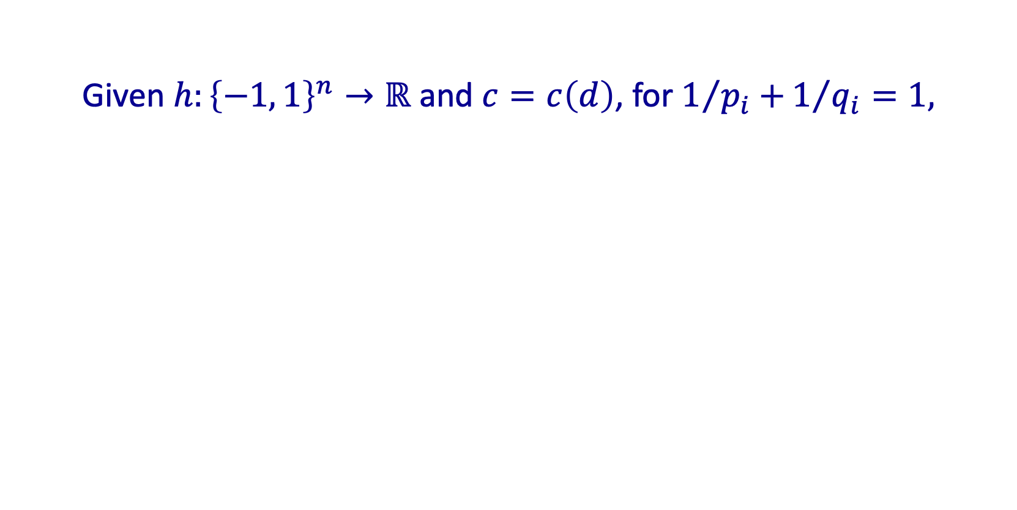
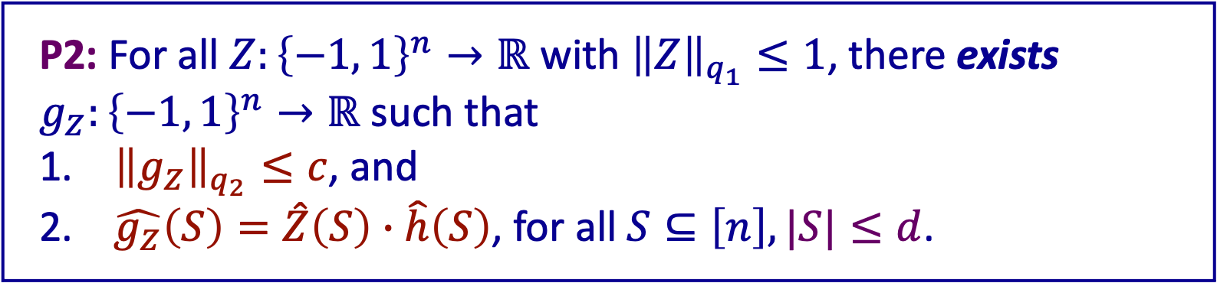
Two equivalent propositions
Given $h:{\left\{−1, 1\right\}}^{n}→ℝ$ and $c=c\left(d\right)$, for $1/{p_{i}+}1/{q_{i}}=1,$
P1: For all $f:{\left\{−1, 1\right\}}^{n}→ℝ$, $\text{deg}\left(f\right)≤d$, ${\left\|h∗f\right\|}_{p_{1}}≤c{\left\|f\right\|}_{p_{2}}$.
P2: For all $Z:{\left\{−1, 1\right\}}^{n}→ℝ$ with ${\left\|Z\right\|}_{q_{1}}≤1$, there exists $g_{Z}:{\left\{−1, 1\right\}}^{n}→ℝ$ such that
${\left\|g_{Z}\right\|}_{q_{2}}≤c$, and
$\hat{g_{Z}}\left(S\right)=\hat{Z}\left(S\right)∙\hat{h}\left(S\right)$, for all $S⊆\left[n\right], |S|≤d$.

Slide 8
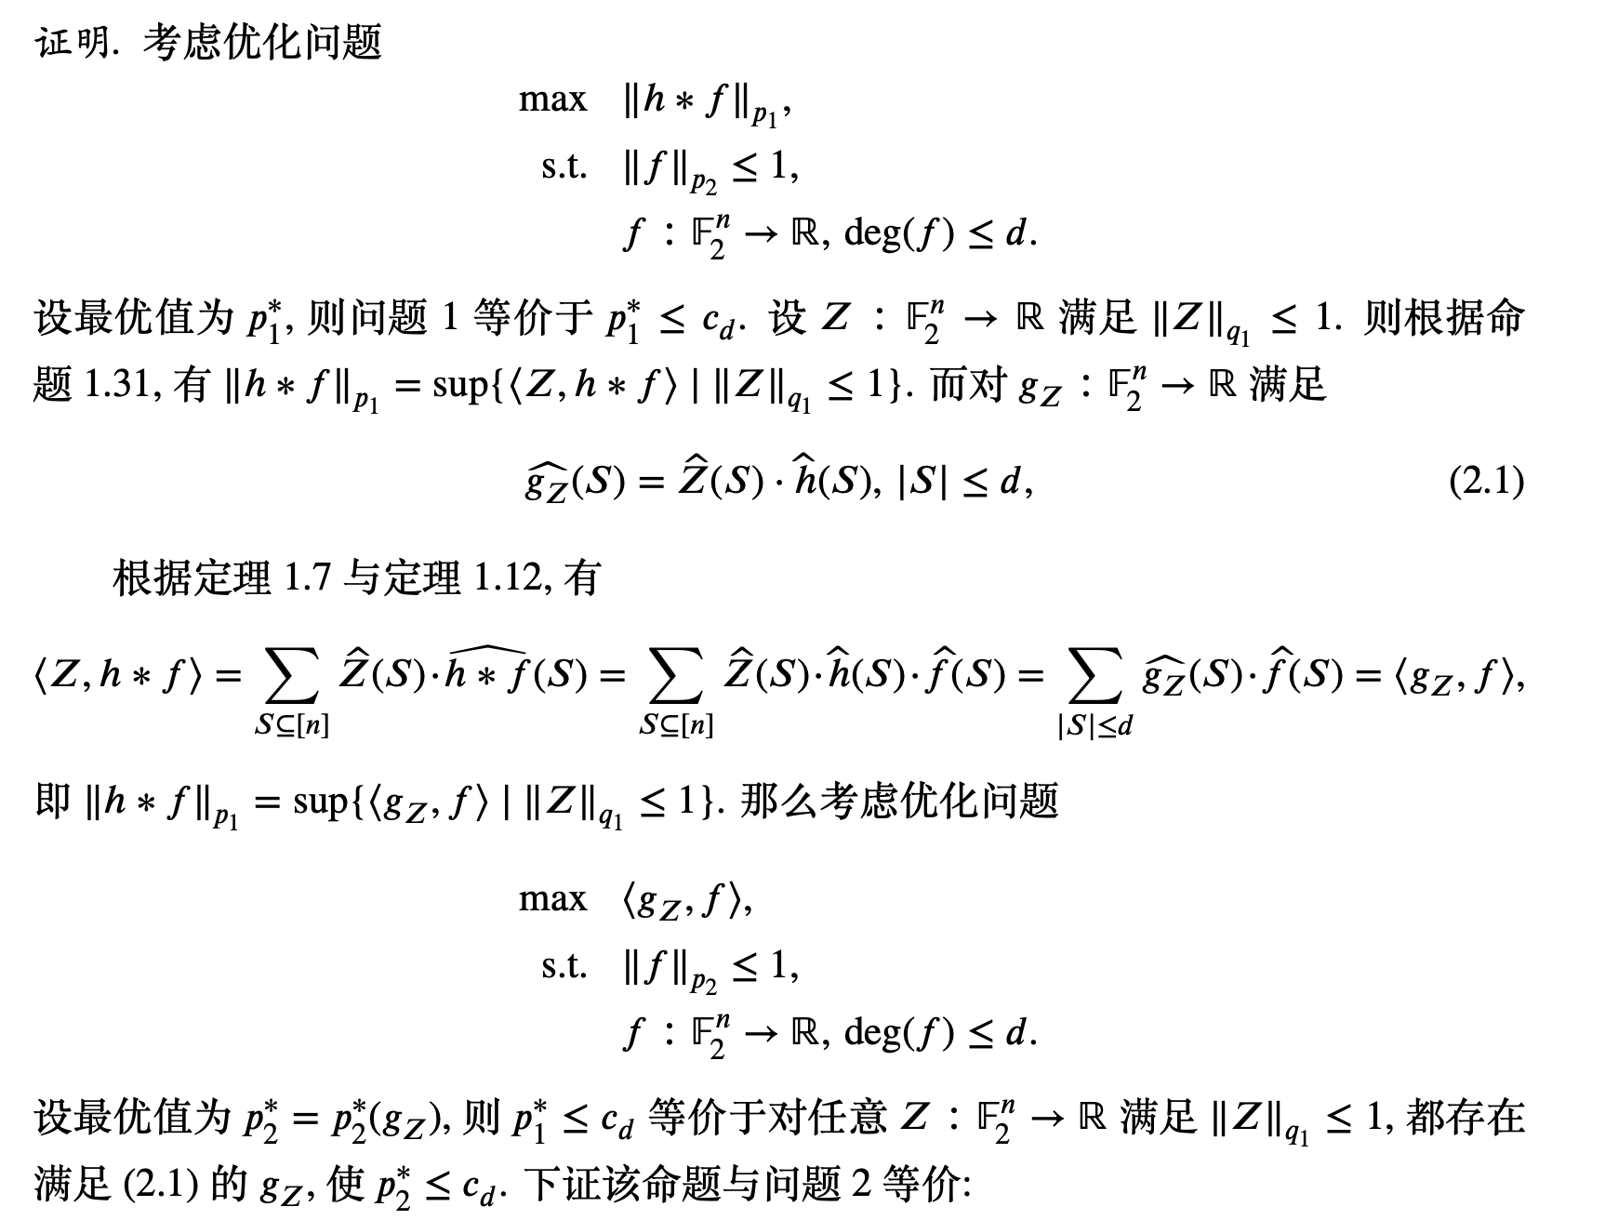

Slide 9
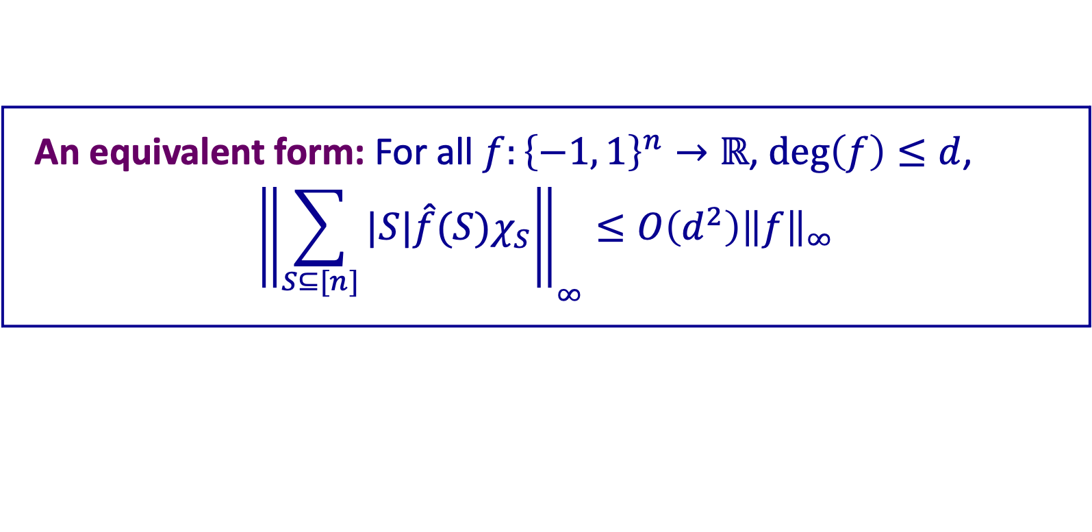
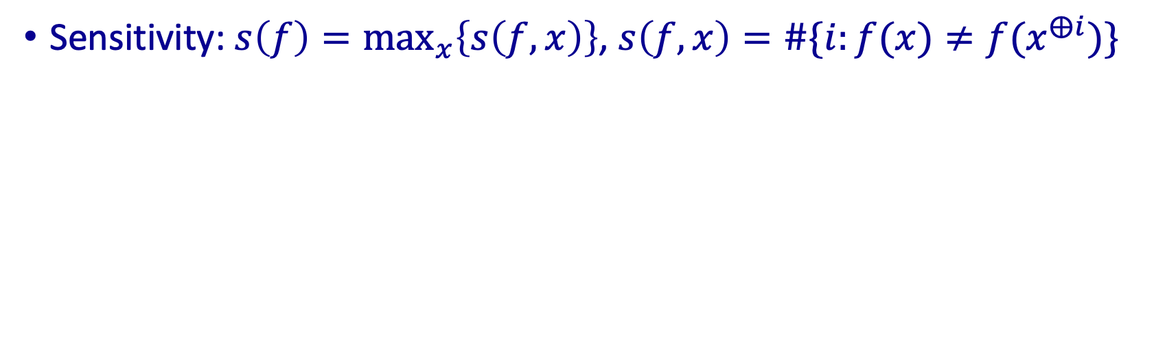
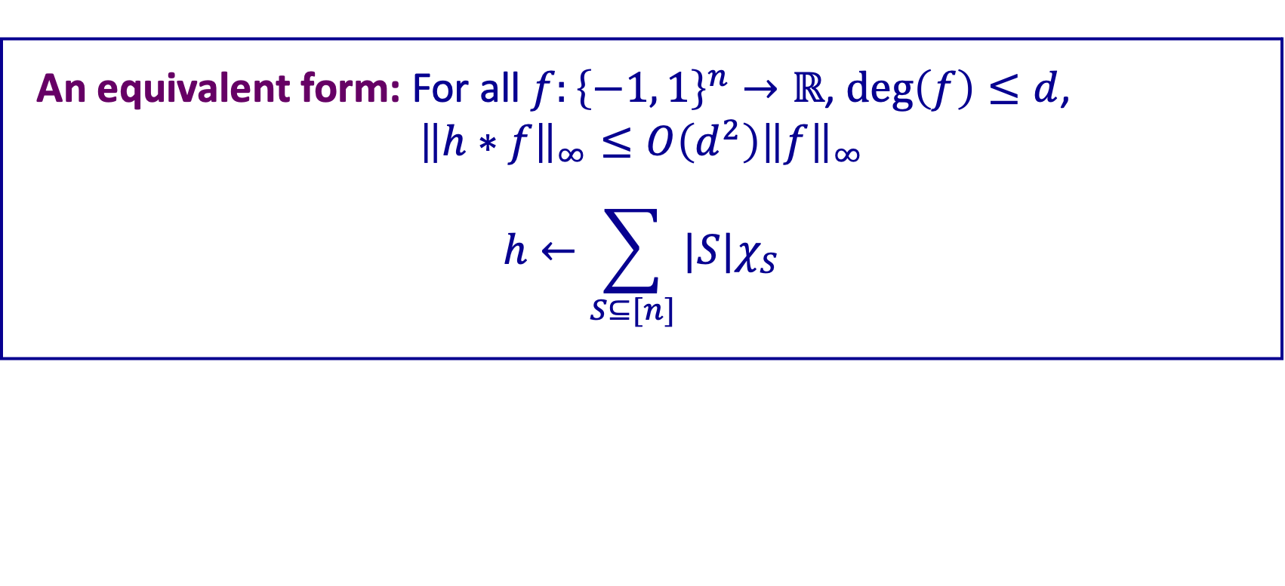
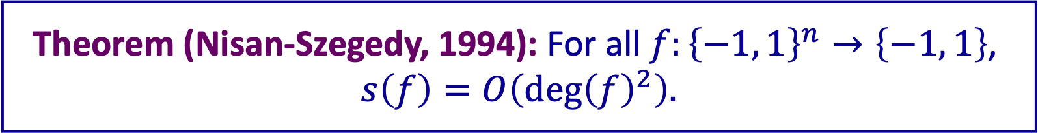
Sensitivity & degree
Theorem (Nisan-Szegedy, 1994): For all $f:{\left\{−1, 1\right\}}^{n}→\left\{−1, 1\right\}$,
$$s\left(f\right)=O\left(\text{deg}{\left(f\right)}^{2}\right).$$
An equivalent form: For all $f:{\left\{−1, 1\right\}}^{n}→ℝ$, $\text{deg}\left(f\right)≤d$,
$${\left\|h∗f\right\|}_{∞}≤O\left(d^{2}\right){\left\|f\right\|}_{∞}$$
$$h←\sum_{S⊆[n]}{|S|χ_{S}}$$
Sensitivity: $s\left(f\right)={\text{max}}_{x}\left\{s\left(f,x\right)\right\}$, $s\left(f, x\right)=\#\{i:f(x)≠f(x^{⨁i})\}$
An equivalent form: For all $f:{\left\{−1, 1\right\}}^{n}→ℝ$, $\text{deg}\left(f\right)≤d$,
$${\left\|\sum_{S⊆[n]}{|S|\hat{f}(S)χ_{S}}\right\|}_{∞}≤O\left(d^{2}\right){\left\|f\right\|}_{∞}$$

Slide 10
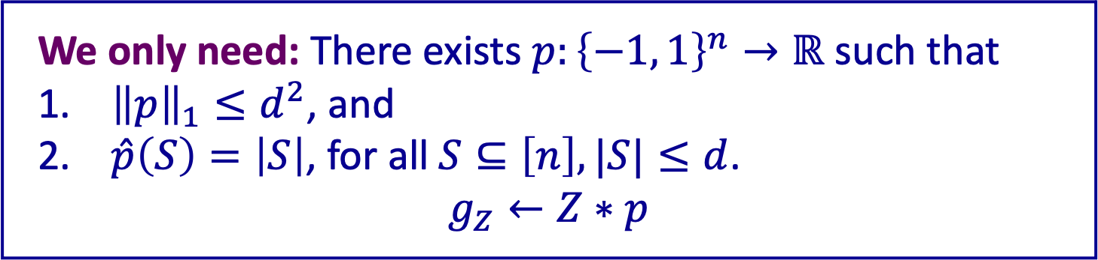
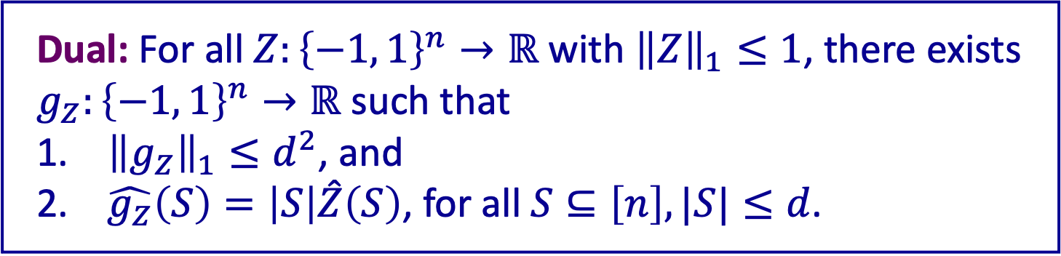
Taking dual ...
Dual: For all $Z:{\left\{−1, 1\right\}}^{n}→ℝ$ with ${\left\|Z\right\|}_{1}≤1$, there exists $g_{Z}:{\left\{−1, 1\right\}}^{n}→ℝ$ such that
${\left\|g_{Z}\right\|}_{1}≤d^{2}$, and
$\hat{g_{Z}}\left(S\right)=\left|S\right|\hat{Z}\left(S\right)$, for all $S⊆\left[n\right], |S|≤d$.
We only need: There exists $p:{\left\{−1, 1\right\}}^{n}→ℝ$ such that
${\left\|p\right\|}_{1}≤d^{2}$, and
$\hat{p}\left(S\right)=\left|S\right|$, for all $S⊆\left[n\right], |S|≤d$.
$$g_{Z}←Z∗p$$

Slide 11
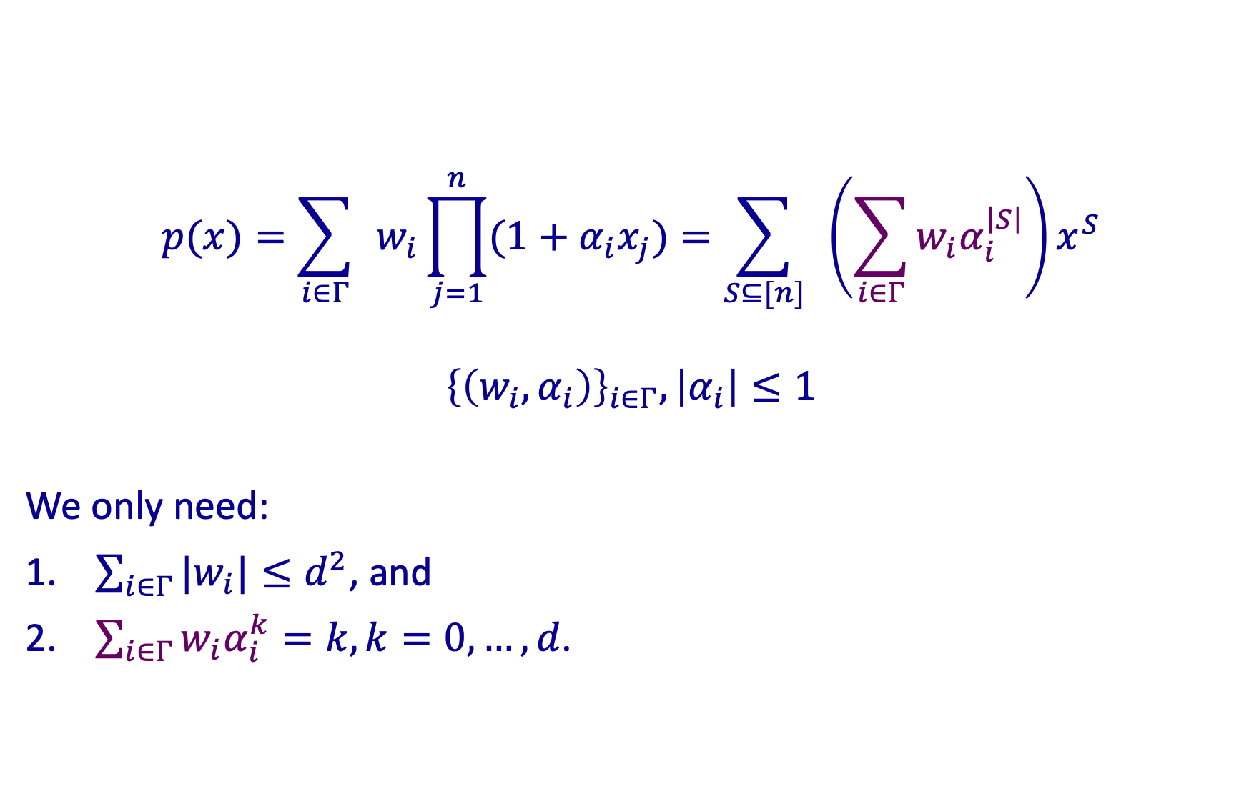

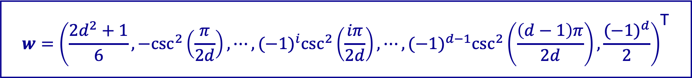
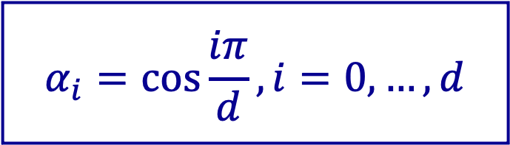
Construct $p$
$$p(x)=\sum_{i∈Γ}{ }w_{i}\prod_{j=1}^{n}{(1+α_{i}x_{j})}=\sum_{S⊆[n]}{ }\left(\sum_{i∈Γ}{w_{i}α_{i}^{\left|S\right|}}\right)x^{S}$$
$${\left\{\left(w_{i},α_{i}\right)\right\}}_{i∈Γ}, \left|α_{i}\right|≤1$$
We only need:
$\sum_{i∈Γ}{{|w}_{i}|≤d^{2}}$, and
$\sum_{i∈Γ}{w_{i}α_{i}^{k}}=k, k=0,…,d$.
$$w={\left(\frac{2d^{2}+1}{6},−\csc^{2}\left(\frac{π}{2d}\right),⋯,(−1)^{i}\csc^{2}\left(\frac{iπ}{2d}\right),⋯,(−1)^{d−1}\csc^{2}\left(\frac{\left(d−1\right)π}{2d}\right),\frac{(−1)^{d}}{2}\right)}^{\text{T}}$$
$$α_{i}=\cos{\frac{iπ}{d}}, i=0,…,d$$

Slide 12
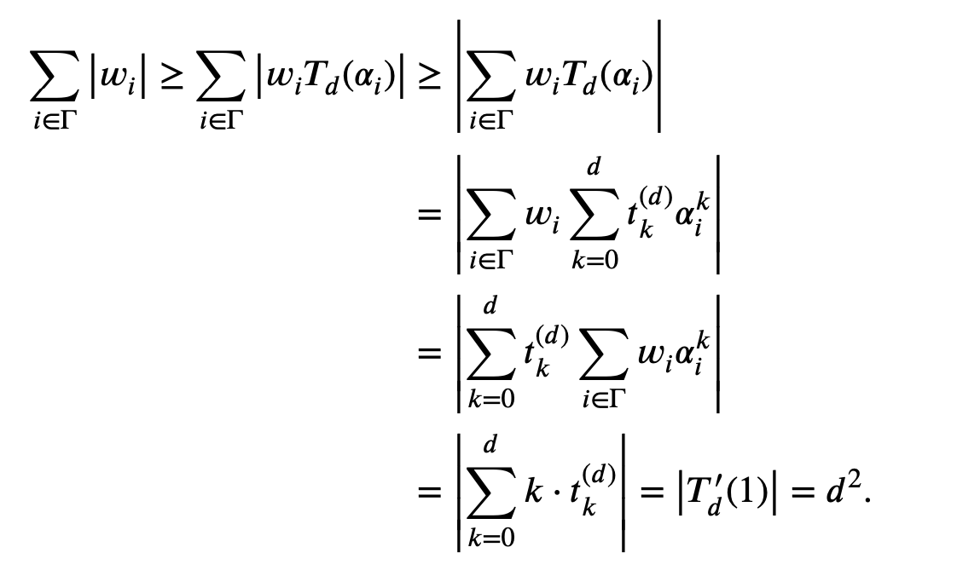

Slide 13
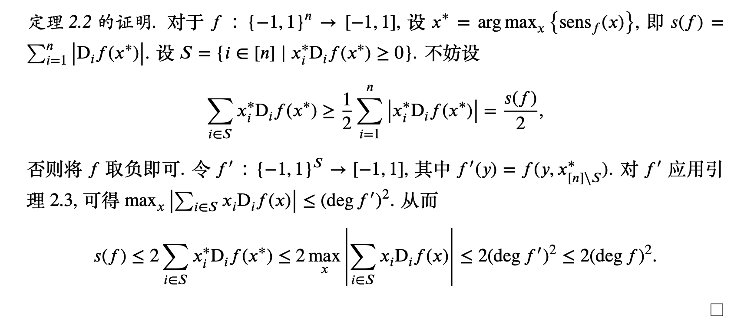

Slide 14
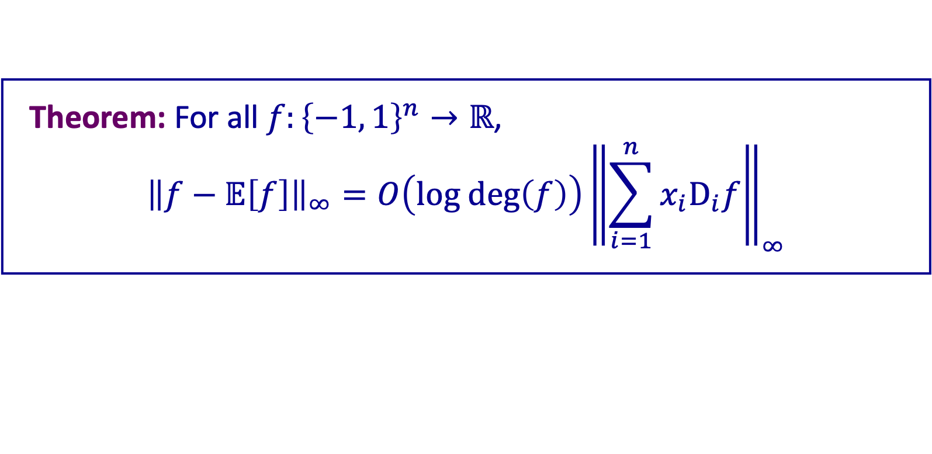
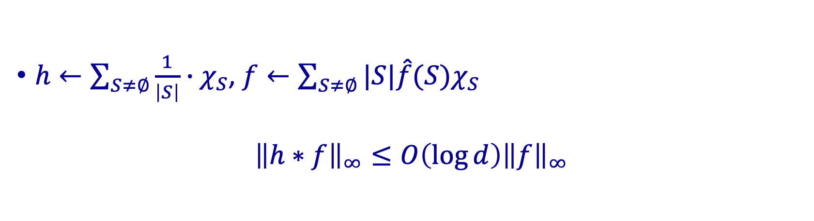
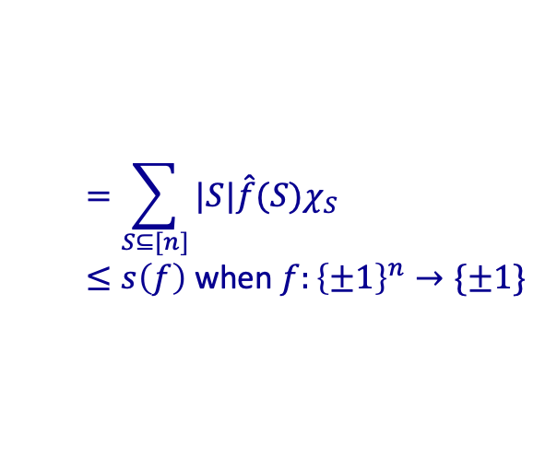
An upper bound on the inf-norm
Theorem: For all $f:{\left\{−1, 1\right\}}^{n}→ℝ$,
$${\left\|f−𝔼\left[f\right]\right\|}_{∞}=O\left(\text{log} \text{deg}\left(f\right)\right){\left\|\sum_{i=1}^{n}{x_{i}{\text{D}}_{i}f}\right\|}_{∞}$$
$$=\sum_{S⊆[n]}{|S|\hat{f}(S)χ_{S}}$$
$≤s\left(f\right)$ when $f:{\left\{±1\right\}}^{n}→\{±1\}$
$h←\sum_{S≠∅}{\frac{1}{\left|S\right|}∙χ_{S}}$, $f←\sum_{S≠∅}{|S|\hat{f}(S)χ_{S}}$
$${\left\|h∗f\right\|}_{∞}≤O\left(\log{d}\right){\left\|f\right\|}_{∞}$$

Slide 15
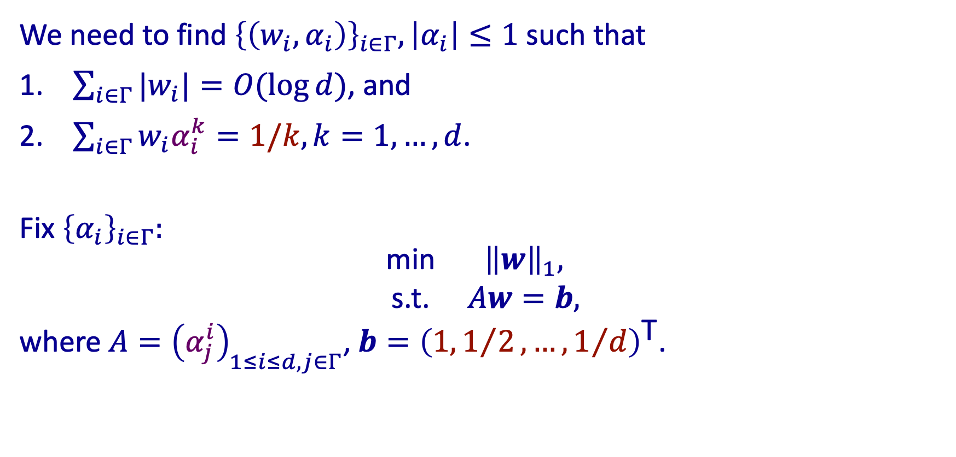

Find $p$
We need to find ${\left\{\left(w_{i},α_{i}\right)\right\}}_{i∈Γ}, \left|α_{i}\right|≤1$ such that
$\sum_{i∈Γ}{{|w}_{i}|}=O(\log{d})$, and
$\sum_{i∈Γ}{w_{i}α_{i}^{k}}=1/k, k=1,…,d$.
Fix ${\left\{α_{i}\right\}}_{i∈Γ}:$
$$\begin{matrix}\text{min} & {\left\|w\right\|}_{1}, \\ \text{s}\text{.}\text{t}\text{.} & Aw=b,\end{matrix}$$
where $A={\left(α_{j}^{i}\right)}_{1≤i≤d, j∈Γ}$, $b={\left(1, 1/2,…,1/d\right)}^{\text{T}}$.

Slide 16
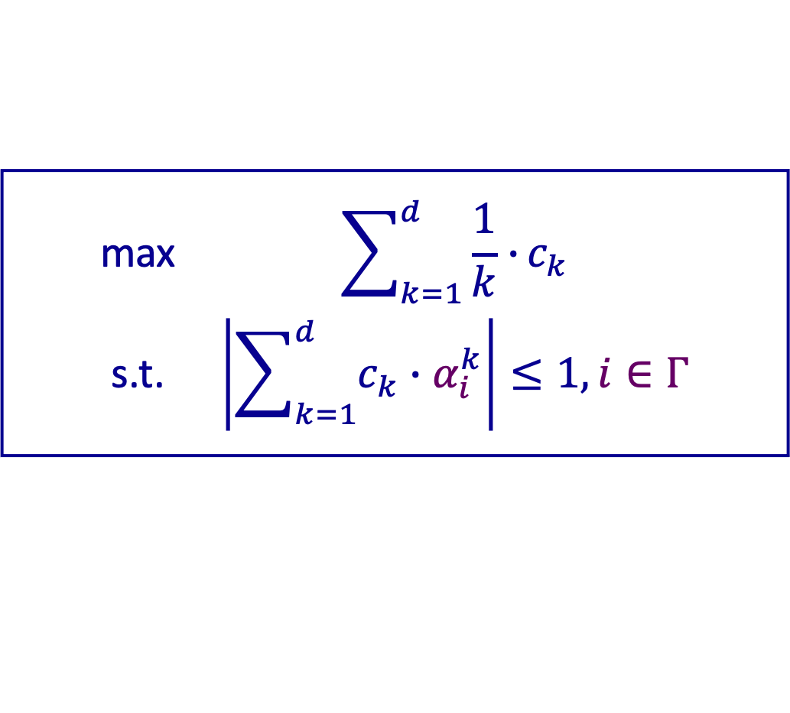

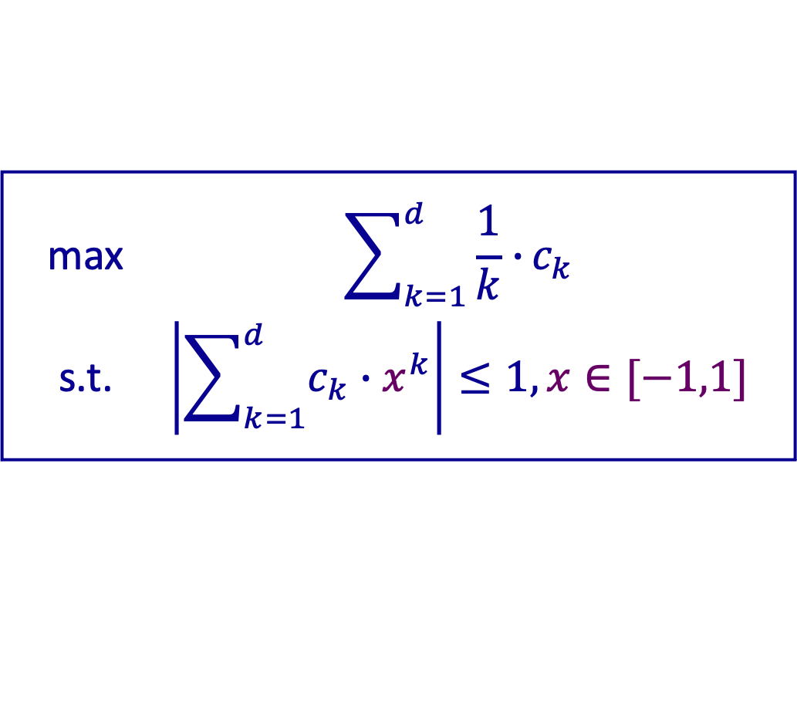
Taking dual again
$$\begin{matrix}\text{max} & \sum_{k=1}^{d}{\frac{1}{k}∙}c_{k} \\ \text{s}\text{.}\text{t}\text{.} & \left|\sum_{k=1}^{d}{c_{k}∙α_{i}^{k}}\right|≤1, i∈Γ\end{matrix}$$
$$\begin{matrix}\text{max} & b^{\text{T}}z \\ \text{s}\text{.}\text{t}\text{.} & {\left\|A^{\text{T}}z\right\|}_{∞}≤1\end{matrix}$$
$$\begin{matrix}\text{max} & \sum_{k=1}^{d}{\frac{1}{k}∙}c_{k} \\ \text{s}\text{.}\text{t}\text{.} & \left|\sum_{k=1}^{d}{c_{k}∙x^{k}}\right|≤1, x∈[−1,1]\end{matrix}$$

Slide 17
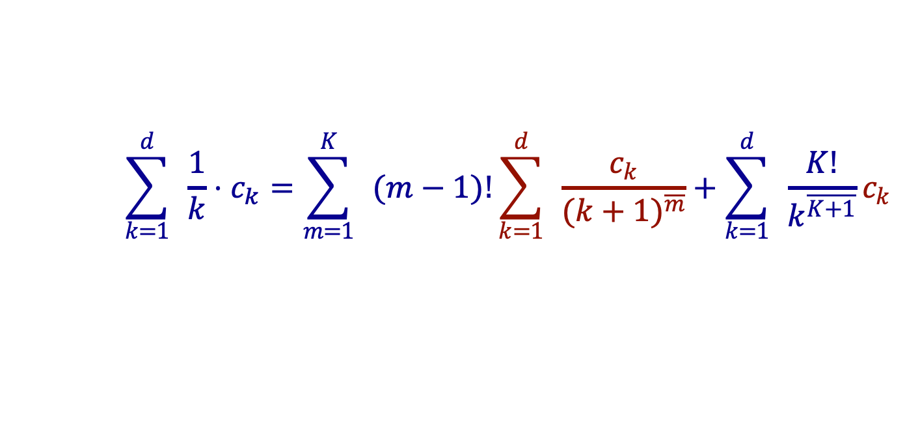

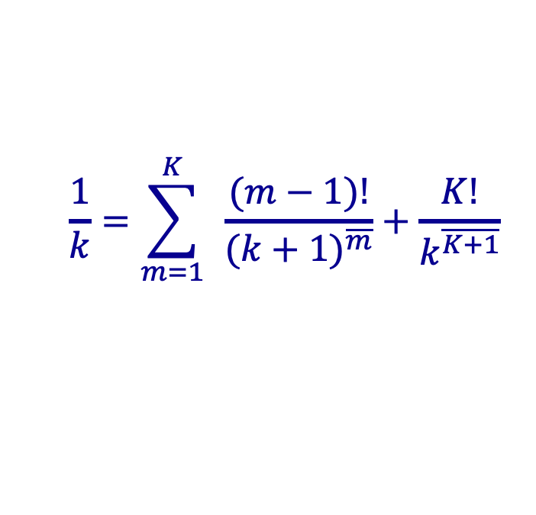
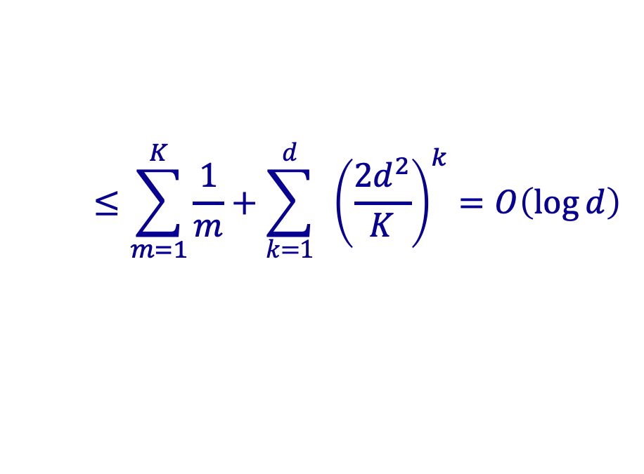
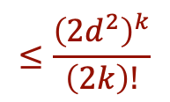
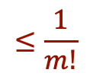
Upper bounding the objective function
$$\frac{1}{k}=\sum_{m=1}^{K}{ }\frac{(m−1)!}{(k+1)^{\overline{m}}}+\frac{K!}{k^{\overline{K+1}}}$$
$$\sum_{k=1}^{d}{ }\frac{1}{k}⋅c_{k}=\sum_{m=1}^{K}{ }(m−1)!\sum_{k=1}^{d}{ }\frac{c_{k}}{(k+1)^{\overline{m}}}+\sum_{k=1}^{d}{ }\frac{K!}{k^{\overline{K+1}}}c_{k}$$
$$≤\frac{{\left(2d^{2}\right)}^{k}}{\left(2k\right)!}$$
$$≤\frac{1}{m!}$$
$$≤\sum_{m=1}^{K}{\frac{1}{m}}+\sum_{k=1}^{d}{ }{\left(\frac{2d^{2}}{K}\right)}^{k}=O\left(\log{d}\right)$$
$$K←4d^{2}$$

Slide 18

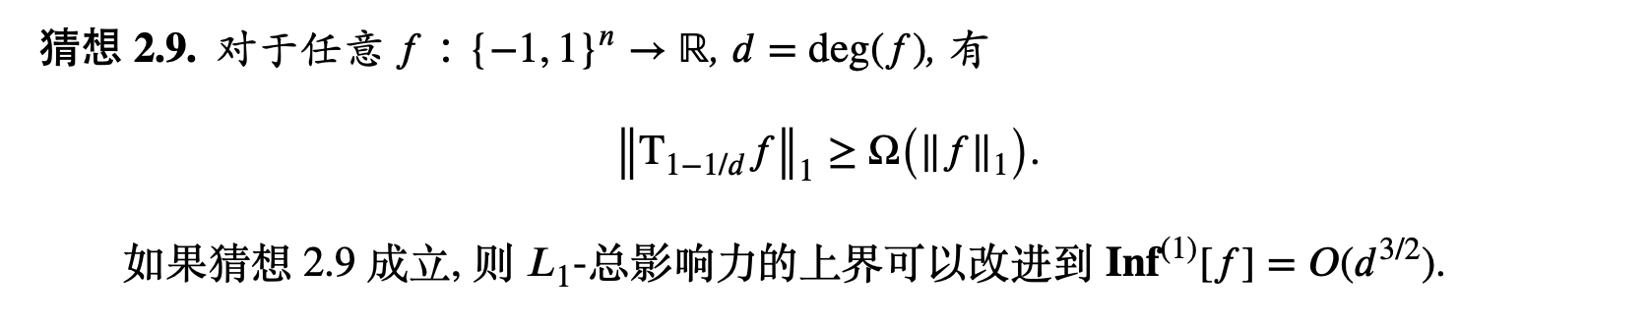

Slide 19
Thank you!

